Slide 1
RFID-based Attendance system
Aastha Hurkat (0827IT151002)
Amay Dubey (0827IT151013)
Avinash Jaisingh (0827IT151023)
Divesh Sharma (0827IT151031)
Ishan Sharma (0827IT151046)
Kajal Dhanotia (0827IT151050)

Slide 2
Contents
Abstract
Introduction
Problem Statement
Survey of existing Systems
Project Objectives
Requirement Analysis
Solution Proposed
Models and Diagrams
Implementation
Conclusion and Limitations

Slide 3
Abstract
This project will help in reducing the manual tiredness of marking attendance manually. Also, the overall cost of this project will be minimised because there is no GSM modules being used, instead, RFID with tags and cards will be used. A unique RFID tag will be provided to each member having the 8-digit code which will be scanned through an RFID reader and the attendance will be entered in the database. The database used will be MySQL and for bridging server side and client side, PHP will be used.

Slide 4
Introduction
This is a unique project in the world of Arduino for marking Online Attendance without using Ethernet and GSM modules. We have developed this unique project to automate the attendance system for offices, schools and universities etc. using RFID RC522 Module and Arduino. For web support and API you need PHP and MySQL. This project costs less than $10.

Slide 5
Problem statement
Tiredness of marking manual attendence
Errors in attendance compilation
Students will be reponsible for marking thir own attendance.
Existing systems make use of Ethernet or GSM modules.

Slide 6
Survey of existing systems
All the existing systems make use of either Ethernet or GSM modules which increases the cost of the product. Also, it requires much maintenance as compared to RFID based systems for example- Biometric Attendance systems.

Slide 7
Project Objectives
To remove the tediousness caused by marking attendance manually.
To reduce the efforts taken to maintain a manual database.
To remove manual/unintentional errors in the attendance systems.

Slide 8
Requirement Analysis
Arduino Uno
The Arduino UNO is an open-source microcontroller board. The board is equipped with sets of digital and analog input/output (I/O) pins
RFID Reader with tags
A radio frequency identification reader is a device used to gather information from an RFID tag, which is used to track individual objects.
PHP Server
A PHP server will work as a bridge between the HTML page and MySQL database. Xampp Apache will be used as a PHP server.
MySQL
MySQL will be the database where all the attendance details of an individual will be stored.

Slide 9
Solution Proposed
Direct entry into DB
No GSM module required
The Attendance system made by us is simply RFID-based in which the student needs to scan his/her RFID tag and the attendance gets stored in the MySQL database.
Build an RFID based attendance System
No Ethernet required

Slide 10
Process
Our system is a simple, easy-to-maintain procedural concept with minimum devices and cost. Anyone can easily operate it without any chances of faults or errors.
first
second
third
last
Add User
Scan Tag
Mark Attendance
View Database
Add/sign-up yourself as a user in the database.
Scan the unique RFID tag given to you in front of the RFID reader.
On scanning, your attendance will be automatcally entered in the database..
The administrator can anytime view the database.

Slide 11
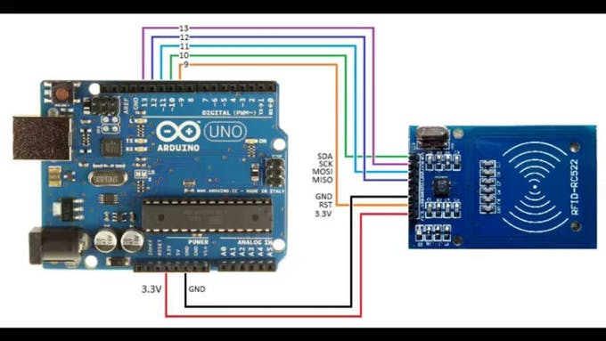
Diagrams and Models
Circuit Diagram

Slide 12
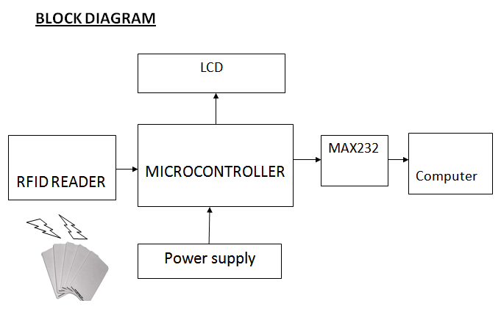
Diagrams and Models

Slide 13
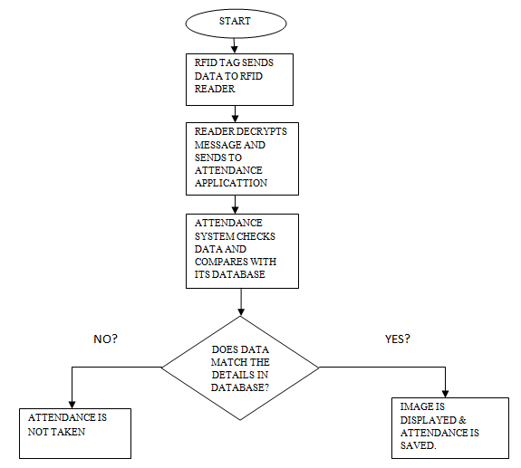
Flow Chart

Slide 14
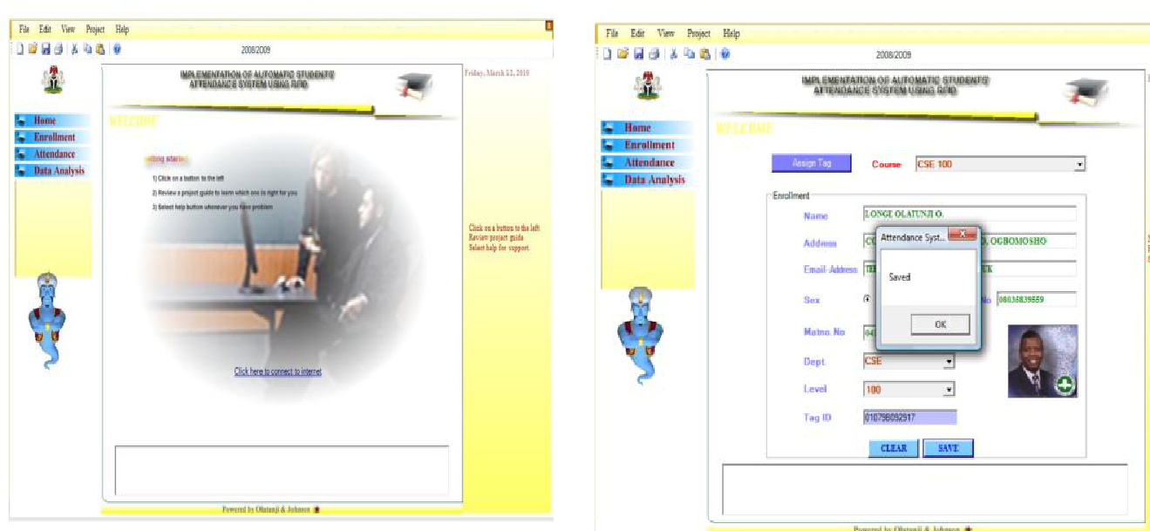
Implementation
Fig 1. Home page Fig 2. Enrolment Interface

Slide 15
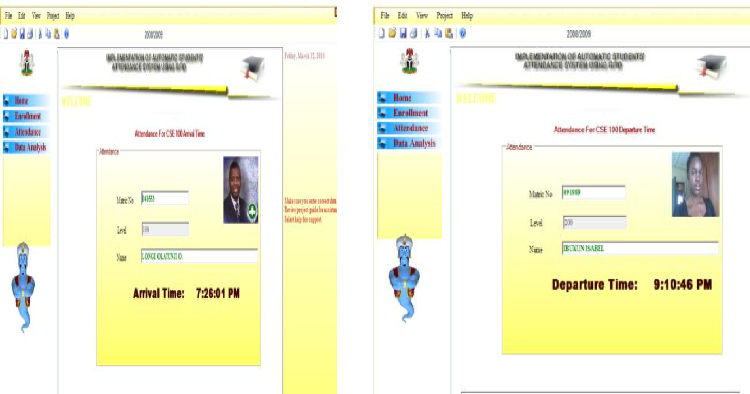
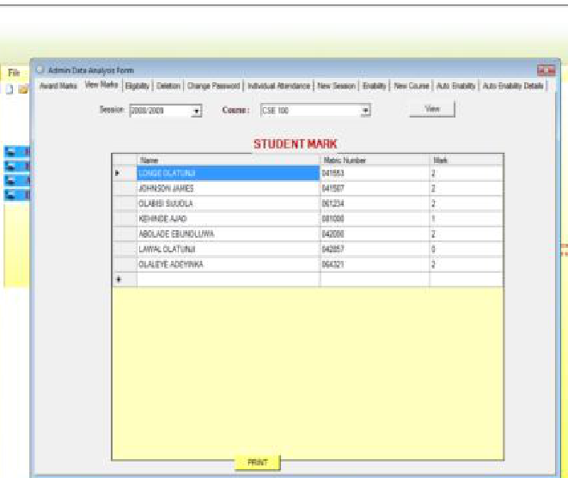
Implementation
Fig 3. Attendance Fig 4. List of students

Slide 16
Conclusion
The RFID based attendance system thus works simply and stores errorless attendance. The viewing and retrieval of attendance is also easy through this system. Thus, this is an affordable system that can be deployed in schools, coaching, colleges, offices etc.

Slide 17
Limitations
The attendance system does not check whether a student is scanning his/her own card or not.

